Slide 1
Anime research
Dec 2022

Slide 2
Problem statement
Sample extraction
How-to
Hypothesis: Search users love to use Coccoc to find and watch manga, anime. However, current system don’t have any function to support this group of user.
Date: 2022-11-01 to 2022-11-20
Type: search queries
Find popular anime sites
Crawl top popular anime form sites (popular all time + popular of month)
Matching name with queries and scoring
Choosing a threshold for anime definition

Slide 3
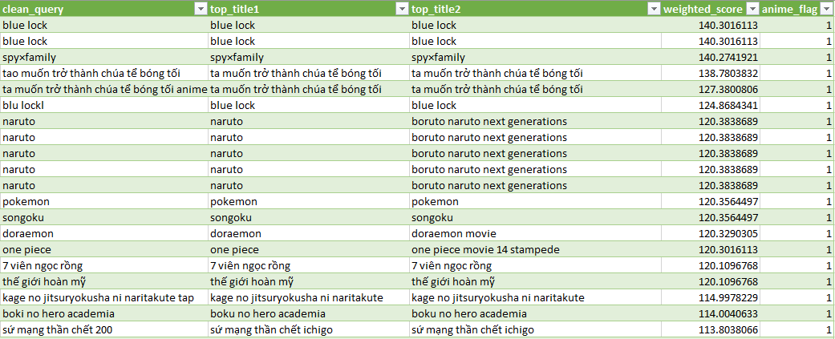
Result

Slide 4
Anime queries can reached up to 2.1%
Statistics
Estimated number
Sample statistics (8 days each)
Sample 1
100 queries
2.0 anime queries
0.5 adult anime queries
Sample 2
100 queries
2.1 anime queries
0.3 adult anime queries
Sample 3
100 queries
2.1 anime queries
0.3 adult anime queries
Estimation based on daily search queries quantity
1000 search queries
~ 21 queries
Contain hentai (adult anime), game with anime theme, manga
Notes:
356 desktop vs. 151 mobile

Slide 5
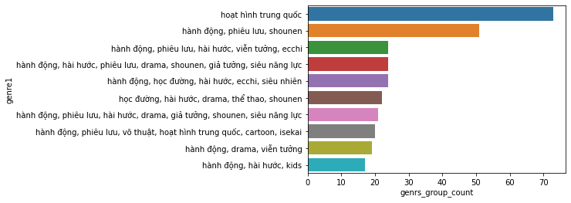
Chinese anime are becoming it own branch that could be consider to highlight in our new function
Notes:
356 desktop vs. 151 mobile

Slide 6
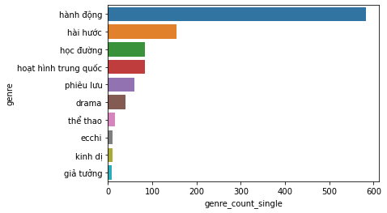
Action, comedy and school-theme are the most popular anime genres, suitable for default result
Notes:
356 desktop vs. 151 mobile

Slide 7
What’s next?
Improve algorithm to implement
Consider to switch to a DS topic
OR improve current scoring system
Extend research if the result is not yet persuasive
Check to see where user click after search
Finding traffic to similar url
Take more samples
Result NOT ok:
Drop Anime, move to next topic

